Slide 1
THE LIFE OF CHRIST
PART 41

Slide 2
Matthew 9:27 When Jesus departed from there, two blind men followed Him, crying out and saying, "Son of David, have mercy on us!" ²⁸ And when He had come into the house, the blind men came to Him. And Jesus said to them, "Do you believe that I am able to do this?" They said to Him, "Yes, Lord." ²⁹ Then He touched their eyes, saying, "According to your faith let it be to you." ³⁰ And their eyes were opened. And Jesus sternly warned them, saying, "See that no one knows it." ³¹ But when they had departed, they spread the news about Him in all that country.

Slide 3
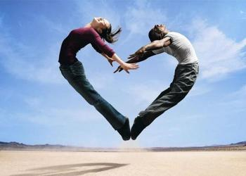

Slide 4
1 Thessalonians 5:17 pray without ceasing,

Slide 5
James 1:5 If any of you lacks wisdom, let him ask of God, who gives to all liberally and without reproach, and it will be given to him. ⁶ But let him ask in faith, with no doubting, for he who doubts is like a wave of the sea driven and tossed by the wind. ⁷ For let not that man suppose that he will receive anything from the Lord; ⁸ he is a double-minded man, unstable in all his ways.

Slide 6
And Jesus said to them, "Do you believe that I am able to do this?" They said to Him, "Yes, Lord." ²⁹ Then He touched their eyes, saying, "According to your faith let it be to you." ³⁰ And their eyes were opened.

Slide 7
Are you telling people about Jesus and what He did for you and how wonderful it is to know that heaven will be your home or do you remain silent?

Slide 8
Matthew 9:32 As they went out, behold, they brought to Him a man, mute and demon-possessed. ³³ And when the demon was cast out, the mute spoke. And the multitudes marveled, saying, "It was never seen like this in Israel!" ³⁴ But the Pharisees said, "He casts out demons by the ruler of the demons."

Slide 9
"It was never seen like this in Israel!"

Slide 10
Mathew 13:53-58 and Mark 6:1-6

Slide 11
Mark 6:1 Then He went out from there and came to His own country, and His disciples followed Him. ² And when the Sabbath had come, He began to teach in the synagogue. And many hearing Him were astonished, saying, "Where did this Man get these things? And what wisdom is this which is given to Him, that such mighty works are performed by His hands! ³ "Is this not the carpenter, the Son of Mary, and brother of James, Joses, Judas, and Simon? And are not His sisters here with us?" And they were offended at Him.

Slide 12
Offended: to put a stumbling block or impediment in the way, upon which another may trip and fall, metaph. to offend… to cause a person to begin to distrust and desert one whom he ought to trust and obey… to see in another what I disapprove of and what hinders me from acknowledging his authority

Slide 13
Mark 6:4 But Jesus said to them, "A prophet is not without honor except in his own country, among his own relatives, and in his own house."

Slide 14
Mark 6:5 Now He could do no mighty work there, except that He laid His hands on a few sick people and healed them. ⁶ And He marveled because of their unbelief. Then He went about the villages in a circuit, teaching.

Slide 15
Matthew 9:35 Then Jesus went about all the cities and villages, teaching in their synagogues, preaching the gospel of the kingdom, and healing every sickness and every disease among the people. ³⁶ But when He saw the multitudes, He was moved with compassion for them, because they were weary and scattered, like sheep having no shepherd. ³⁷ Then He said to His disciples, "The harvest truly is plentiful, but the laborers are few. ³⁸ "Therefore pray the Lord of the harvest to send out laborers into His harvest."

Slide 16
Matthew 10:1 And when He had called His twelve disciples to Him, He gave them power over unclean spirits, to cast them out, and to heal all kinds of sickness and all kinds of disease. ² Now the names of the twelve apostles are these: first, Simon, who is called Peter, and Andrew his brother; James the son of Zebedee, and John his brother; ³ Philip and Bartholomew; Thomas and Matthew the tax collector; James the son of Alphaeus, and Lebbaeus, whose surname was Thaddaeus; ⁴ Simon the Canaanite, and Judas Iscariot, who also betrayed Him.

Slide 17
Matthew 10:5 These twelve Jesus sent out and commanded them, saying: "Do not go into the way of the Gentiles, and do not enter a city of the Samaritans. ⁶ "But go rather to the lost sheep of the house of Israel. ⁷ "And as you go, preach, saying, 'The kingdom of heaven is at hand.' ⁸ "Heal the sick, cleanse the lepers, raise the dead, cast out demons. Freely you have received, freely give. ⁹ "Provide neither gold nor silver nor copper in your money belts, ¹⁰ "nor bag for your journey, nor two tunics, nor sandals, nor staffs; for a worker is worthy of his food.

Slide 18
¹¹ "Now whatever city or town you enter, inquire who in it is worthy, and stay there till you go out. ¹² "And when you go into a household, greet it. ¹³ "If the household is worthy, let your peace come upon it. But if it is not worthy, let your peace return to you. ¹⁴ "And whoever will not receive you nor hear your words, when you depart from that house or city, shake off the dust from your feet. ¹⁵ "Assuredly, I say to you, it will be more tolerable for the land of Sodom and Gomorrah in the day of judgment than for that city!

Slide 19
Matthew 10:16 Behold, I send you out as sheep in the midst of wolves. Therefore be wise as serpents and harmless as doves. ¹⁷ "But beware of men, for they will deliver you up to councils and scourge you in their synagogues. ¹⁸ "You will be brought before governors and kings for My sake, as a testimony to them and to the Gentiles. ¹⁹ "But when they deliver you up, do not worry about how or what you should speak. For it will be given to you in that hour what you should speak;

Slide 20
²⁰ "for it is not you who speak, but the Spirit of your Father who speaks in you. ²¹ "Now brother will deliver up brother to death, and a father his child; and children will rise up against parents and cause them to be put to death. ²² "And you will be hated by all for My name's sake. But he who endures to the end will be saved. ²³ "When they persecute you in this city, flee to another. For assuredly, I say to you, you will not have gone through the cities of Israel before the Son of Man comes.

Slide 21
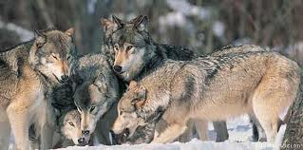
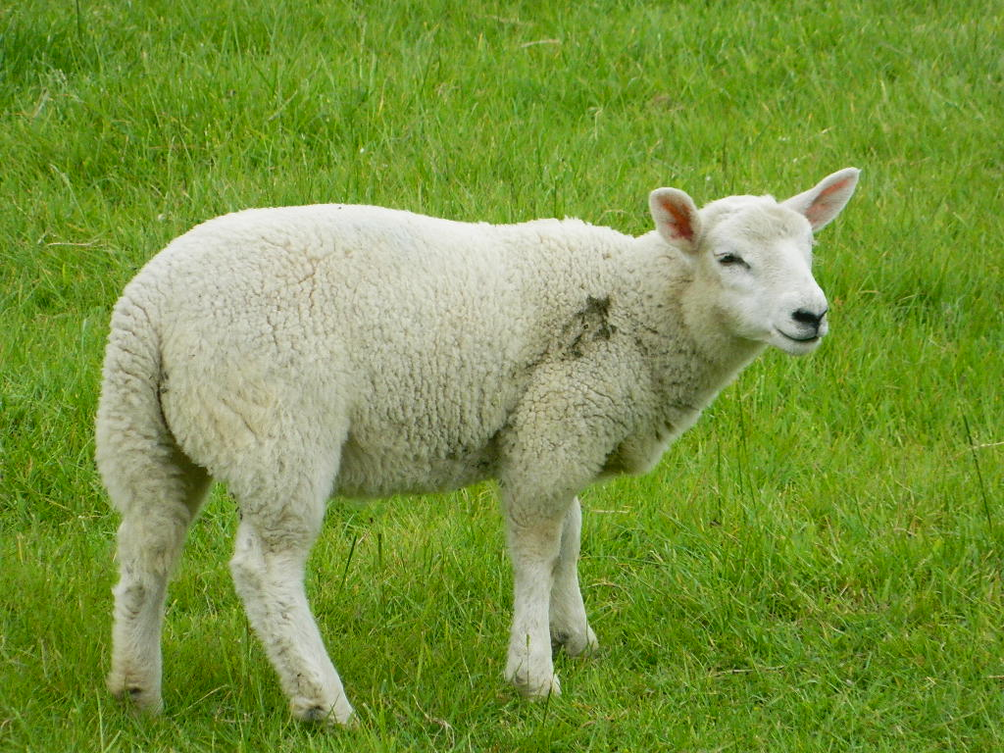

Slide 22
For assuredly, I say to you, you will not have gone through the cities of Israel before the Son of Man comes.

Slide 23
1. The destruction of Jerusalem (Mt 24:29-31).
2. The Son coming into His dominion as King on the day of Pentecost.
3. The final judgment.

